Slide 1

All Services Solution USA

Slide 2

Vision – Mission & Values.
Vision. To become the Best in Class non- emergency medical transportation service provider.
Mission. To provide safe, on time, economical, and appropriate transportation to all patients
Values. Respect , Pride and Compassion understanding the impact of service at the human level and not only as a transport provider.

Slide 3

Major players
There are currently three transportation brokers responsible Medicaid NEMT for the state.
Access2Care
Presence in 29 States
Over 8.6 Millions Rides/Year
Open to accept new Transportation Providers
Offer Training to assure excellent transportation service
See Forms: Credential Application and Transportation Service Application
LogistiCare
Is the largest NEMT company in USA, with presence in 39 States
Over 69 Millions Rides/Year
Open to accept new Transportation Providers
Offer Training to assure excellent transportation service

Slide 4

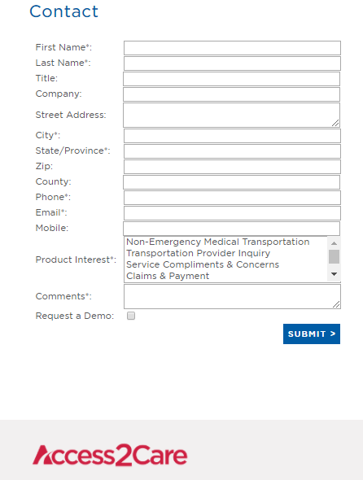
Step 1.
Access2Care: Contact & Application Form

Slide 5

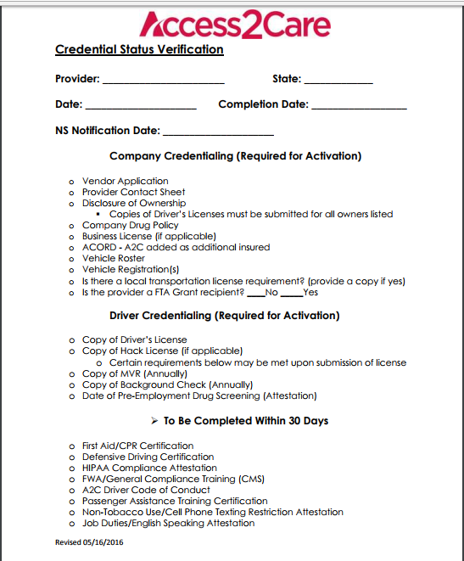
Step 2
Access2Care: Credential Status Verification Form

Slide 6

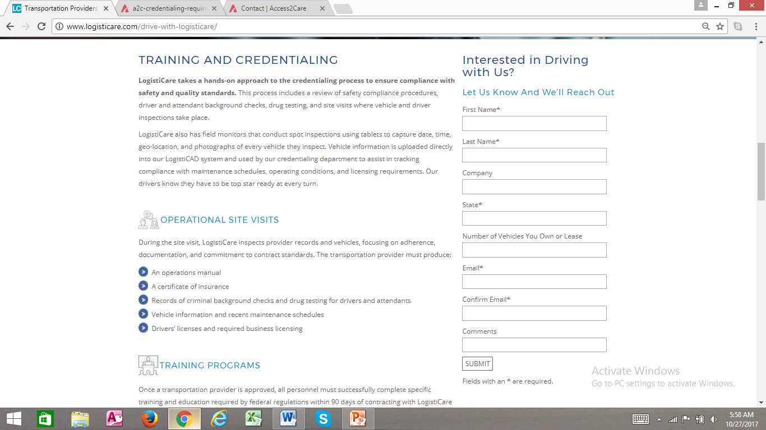
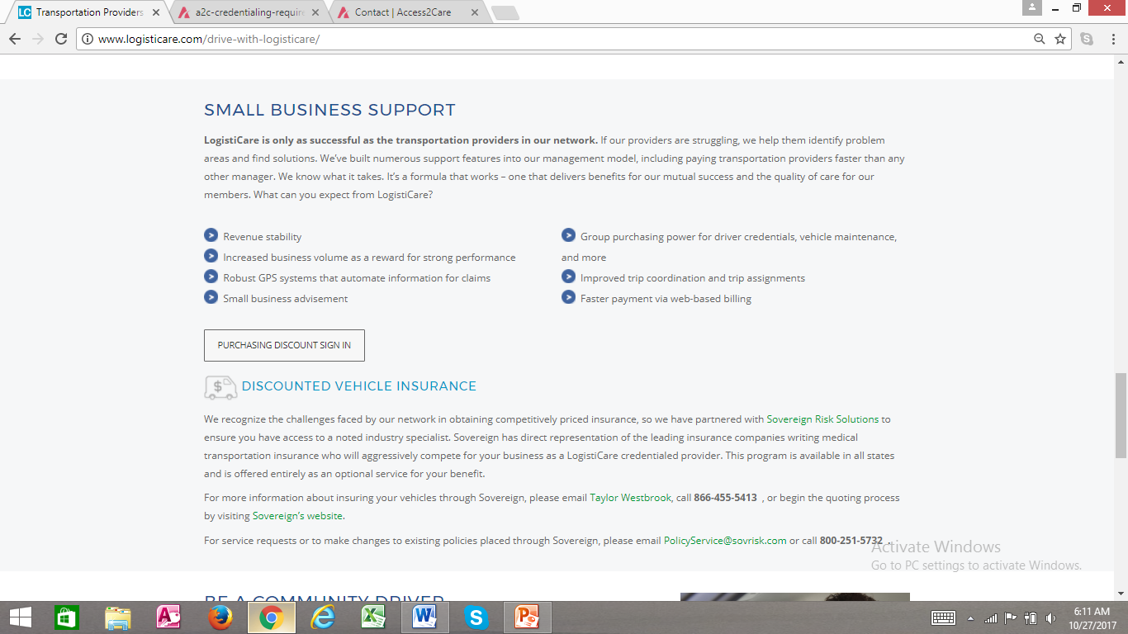
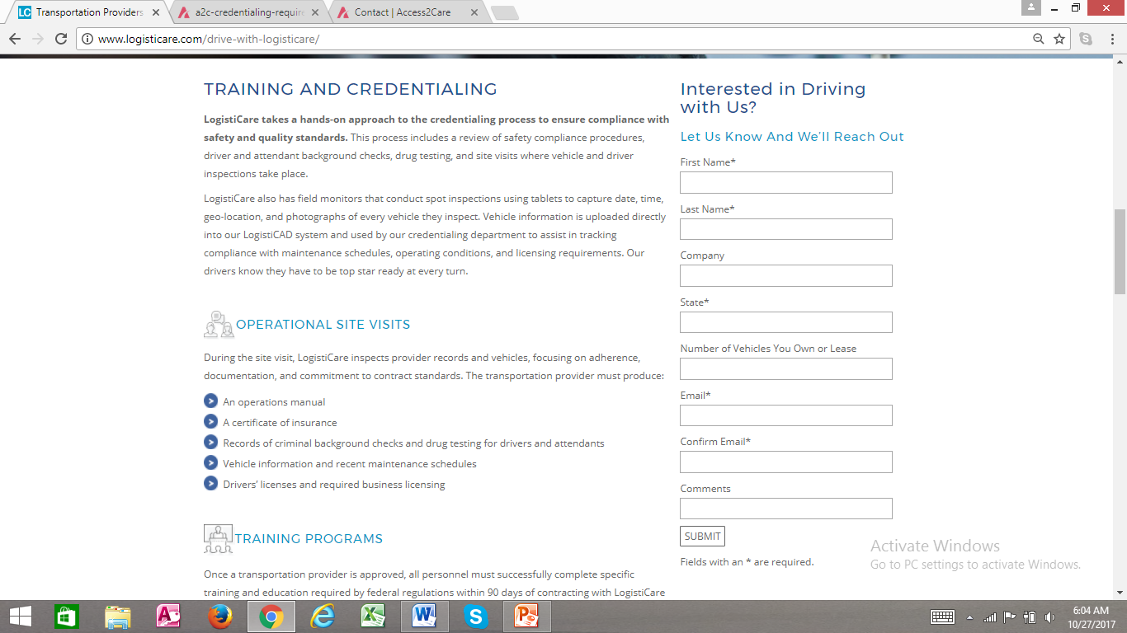
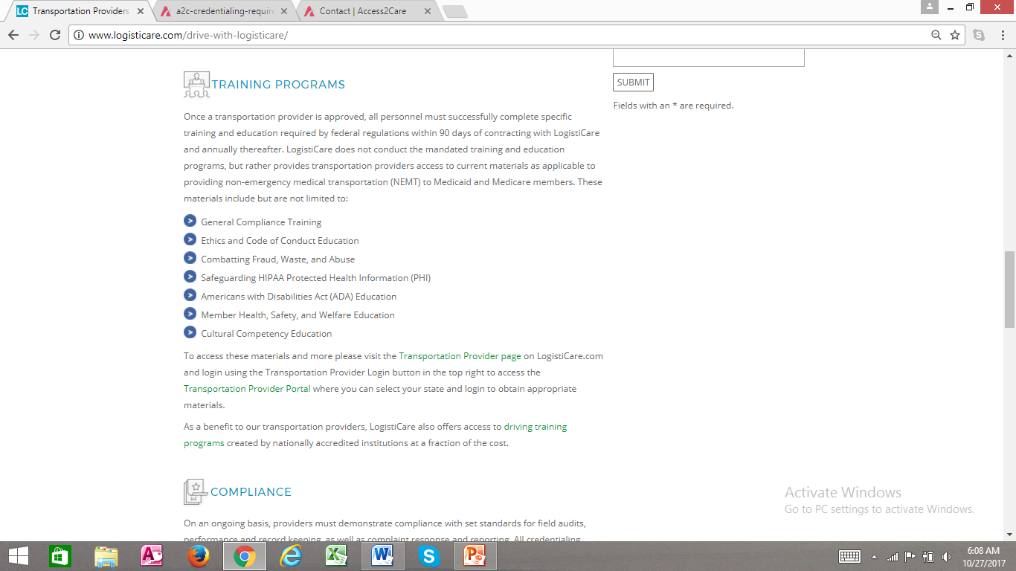
Step 3
Training & Credential
Operational Site Visit
Small Business Support
Training Program

Slide 7
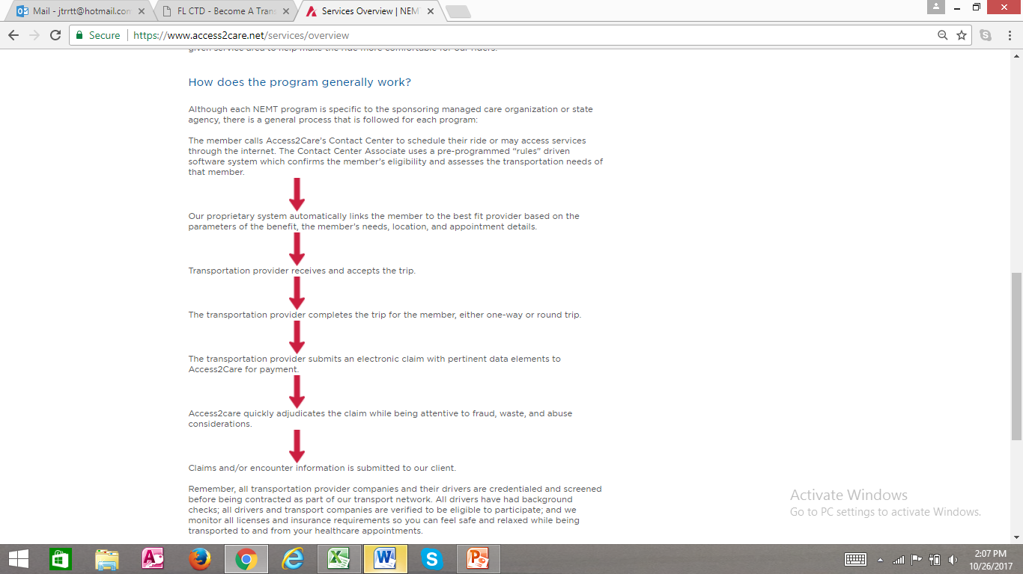
How does the program works.
Access2Care: (Not Emergency Medical Transportation – NEMT)

Slide 8
Company documents
Completed A2C application (see attached-complete, sign, and date).
Current Insurance ACORD with A2C listed as an additional insured/certificate holder.
(See attached example-we require BOTH Auto Liability and General Liability in matching amounts. Any company with 4 or more employees are required to have Worker’s Compensation Coverage per the State of Florida. If you do not have Workers Comp coverage an exemption letter must be provided)
Current driver roster (see attached)
Current vehicle roster (see attached)
Copies of vehicle registrations
Copy of W-9 (see attached)
ACH Form (attached) & Voided Check
Copies of Business License (if applicable, if not applicable need something in writing stating so)
Copy of Substance Abuse Policy (see attached-sign/date)
Completed Ownership Disclosure Form & Copies of the DL of anyone listed on the form (see attached)
Company Contact Sheet (see attached)
List of all non-driver employees roster (need name, job function, DOB, and SS # for OIG exclusion purposes). If you have none, please indicate as such on attached roster
Vehicle Inspection Attestation (see attached)

Slide 9
Company documents / forms
8. Business Licenses. If applicable ?
1. Application
9. Ownership disclosure form and copies.
2. Insurance Accord
3. Drivers Roaster
10. Company contact Sheet
11. List of all Non- Driver employees .
4. Vehicle Roaster
12. Vehicle Inspection.
5. Vehicle Registration.
13. Copy of substance abuse
6. Copy W-9.
7. ACH Form.

Slide 10
Driver documents
FWA attestations (see attached)
HIPPA Training (see attached)
No smoking/texting while driving attestation (see attached)
Code of Conduct (see attached)
Job duties attestation (see attached)
First-Aid/CPR Training
Defensive Driving Training certification
Primary Credentials
Driver Credentialing Checklist (see attached) –please completed and return to me along with copies of:
Driver’s license (clear and legible)
MVR (motor vehicle record) Must be run within the past 90 days.
7 Year National background check. Must be run in the past 90 days.
Pre-employment drug test
Passenger Assistance Training certification
*** One attachment not listed related to rates =

Slide 11

How we do Business…..

Slide 12

Next Steps.

